Slide 1
Enterprise Project Server 2016 Project Online
Hari Thapliyal

Slide 2
Features

Slide 3
20-point Checklist for New Projects
Define what type of WBS you want to use (Phase driven, Department Driven, Component Driven)
First define your project deliverables and product deliverables (features of products) and then create WBS
Define activities with activity attributes
Determine what organization specific activity attribute you need to capture like department, location, own, type of activity (FD, FW, FU), Constraints, Deadline, Efforts, Duration, Priority, Cost, Costing Method, Earn Value Method, Overall Health, lead & lag, dependency on, dependency type, dependency nature etc.
Sequence activities based on dependency, lead & lag
Estimate Resources type and number. Estimate first with skill, then with role or generic resource. Not with name.
Estimate duration. Estimate buffer separately and manage it separately.
Check your critical path. To manage project within schedule, you must use buffer on critical path activities.
Optimize your schedule to meet maximum project objective. Use techniques like crashing, what-if, fast-tracking, alternative analysis
Negotiate your final schedule with critical path activities, assumption and confidence level.

Slide 4
20-point Checklist for New Projects
Must baseline your schedule before you start working on that
Tracking activities on daily basis and keep your plan updated always
Prepare progress and status report proactively which should contain corrective and preventive action, if need any
No task should have estimate violating 8/80 rule
Do not assign resource to summary activity
Do not assign dependency on summary activity, a normal activity can depend upon summary activity
For external activities use lag not duration or effort estimates
Always use departmental or project nature based template to create project schedule
When creating template from schedule, do not save cost, named resource, actuals and notes.
Consider rebaselining if too much change has occurred in the schedule

Slide 5
Work, Unit, Duration Puzzel
Work = Unit x Duration => 1 Person x 1 Day = 1 Person Day = 8 Person Hours
Fixed Work
You change work => Duration changes
You change units => Duration changes
You change duration => Gives options to change unit (Default) or work
Fixed Duration
You change duration => Work changes
You change units => Work changes
You change work => Gives option to change Unit (default) or duration
Fixed Unit
You change units => Work changes
You change duration => Work changes
You change work => Gives option to change Duration (Default) or units

Slide 6
Resource Leveling
Keynotes about MSP 2007/2010 Resource Leveling
Project levels only the work resources, generic resources and committed resources
It does not level the material resources, cost resources and proposed resources
Prior to level set the task priorities
If you don't want project to level a particular task, set its priority level to 1000
Task with lower priority level are split before those that have higher priority
MS Projects calculates everything to Minutes and some resource red does not mean that it is over-allocated on week or day basis

Slide 7
Project 2016 Features
Build and Manage Schedules
Flexible Web-based Scheduling
Editable web-based schedules:
Consistent and familiar user experience
Multi-level Undo and Change Highlighting
Collaborate With Team Easily
Provide a central location for team collaboration
Manage content efficiently
Link documents with project tasks
Use social platforms to convey project information
Communicate Information Effectively
Format and print one-page schedules or other reports
Easily export Project data into Microsoft Office tools
Quickly Access The Information You Need
Predefined or Custom Metrics
Track Scope and Schedule Changes
Gain Superior Control of Resources and Finances
Easily assign resources to tasks
Adjust the task assignments to solve clashes over allocations
Govern finances by assigning budgets to projects and programs
Improve your cost estimates with Cost Resources
Gain Strategic Visibility into Business Performance and Make Informed Decisions
Control projects from a central location and measure performance easily
Create custom status reports to gather and bring together progress updates from team members
Create reports using best-practice report templates from Business Intelligence Center
Create reports and powerful dashboards easily
Track Projects as Per Your Needs
Set Baselines:

Slide 8
Features of Project Server 2010 Hosting
Quick Report Generation— Microsoft Project Server 2010 helps you to easily fetch reports whenever you want. You can print one-page schedules or reports directly from the tool. You can also export your report data to MS Office products such as Excel, PowerPoint and Visio, as per your requirements. Dynamic reports can be fetched in form of charts, diagrams, and graphs.
Extensible and Programmable—Built on the .NET framework, MS Project Server can be customized to work as per your business systems and processes. You can install Project Server 2010 via an API with Excel services. APIs and Project Server Event Model work together to display the data inside the client applications to trigger the business processes workflow.
Timesheets—The timesheet feature in Project 2010 server allows you to report the time spent on project or non-project activities. Timesheets track actual work time, which can be guarded through auditing.
Project Budget Control—With Microsoft Project 2010 Server, you can now control your finances spent on the project. The Budget field allows you to allot your budget by identifying costs for each resource.
Enterprise Templates—Enterprise templates in hosted Project Server 2010 allow you to create standardized templates for use across your enterprise. This MS Project Server feature allows you to have standard naming conventions, scheduling logic and project structures.
Resource Management—Project Server 2010 hosting solution enables you to manage your resources which include equipment, people and materials that are required to finish a project. Project Server’s resource management feature helps you to centrally store resources in a Project Server database which can be accessed anytime from anywhere.
Update through Web—Professional client applications are not required for project updates. You can directly manage resources or update tasks in the MS Project 2010 Server. Soon after the publishing of the project plan, resources can view their tasks via Project Web Access (PWA).
Project Center—Project Center allows stakeholders and executives to view multiple project status at a glance.
Built on SharePoint—Microsoft Office Project Server 2010 is built on SharePoint 2010, which allows for collaboration and central management and tracking of issues, documents, and risks. Centralized management allows users to enhance the quality of their deliverables.
Risk Management—Microsoft Project 2010 Server identifies risks early and prompts you to alleviate them. Project Managers can set baselines for time and cost of the assignment. Microsoft Project Server tracks the discrepancy between the actual data and baseline. If the discrepancy is more, then the project manager is alerted about the same.

Slide 9
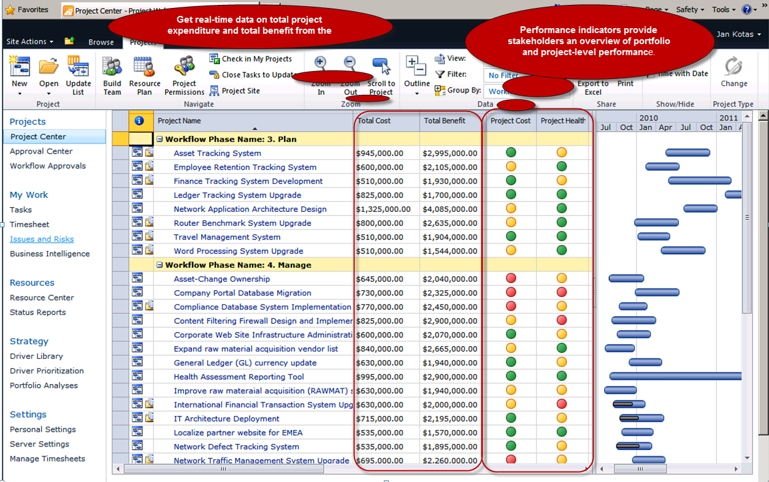
Control projects from a central location and measure performance easily

Slide 10
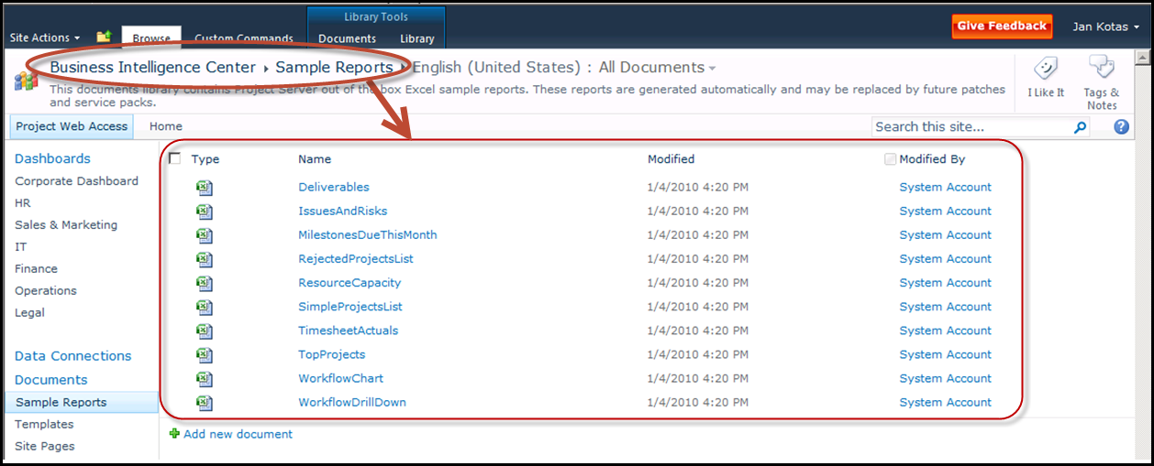
Create reports using best-practice report templates from Business Intelligence Center

Slide 11
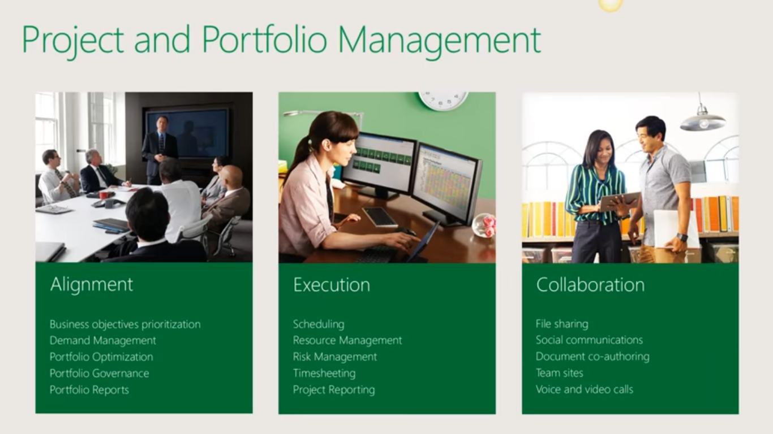

Slide 12
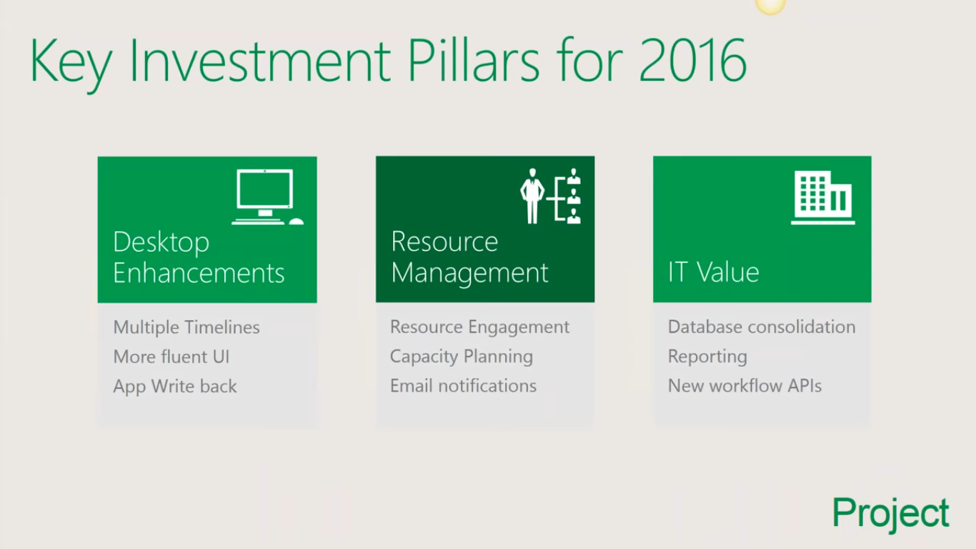

Slide 13
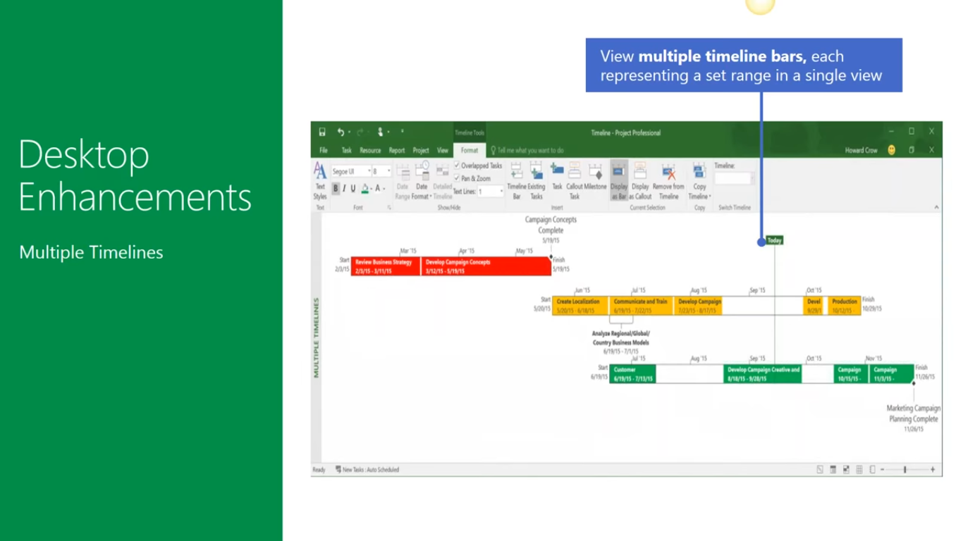

Slide 14
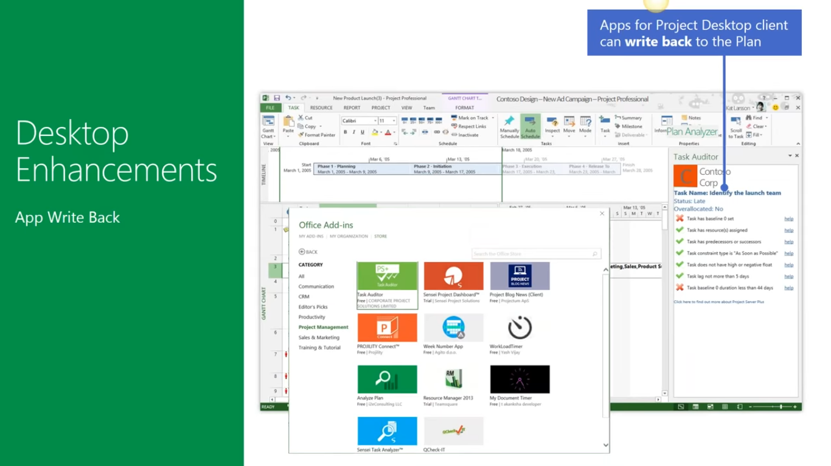

Slide 15
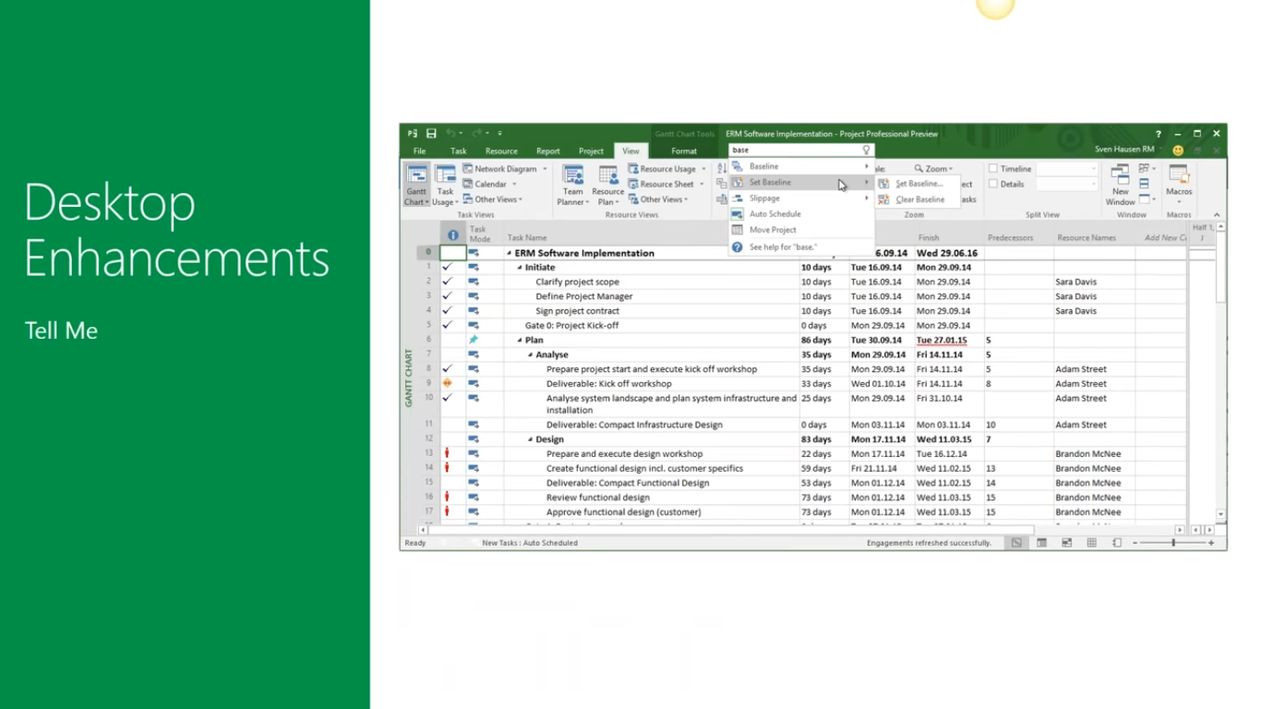

Slide 16
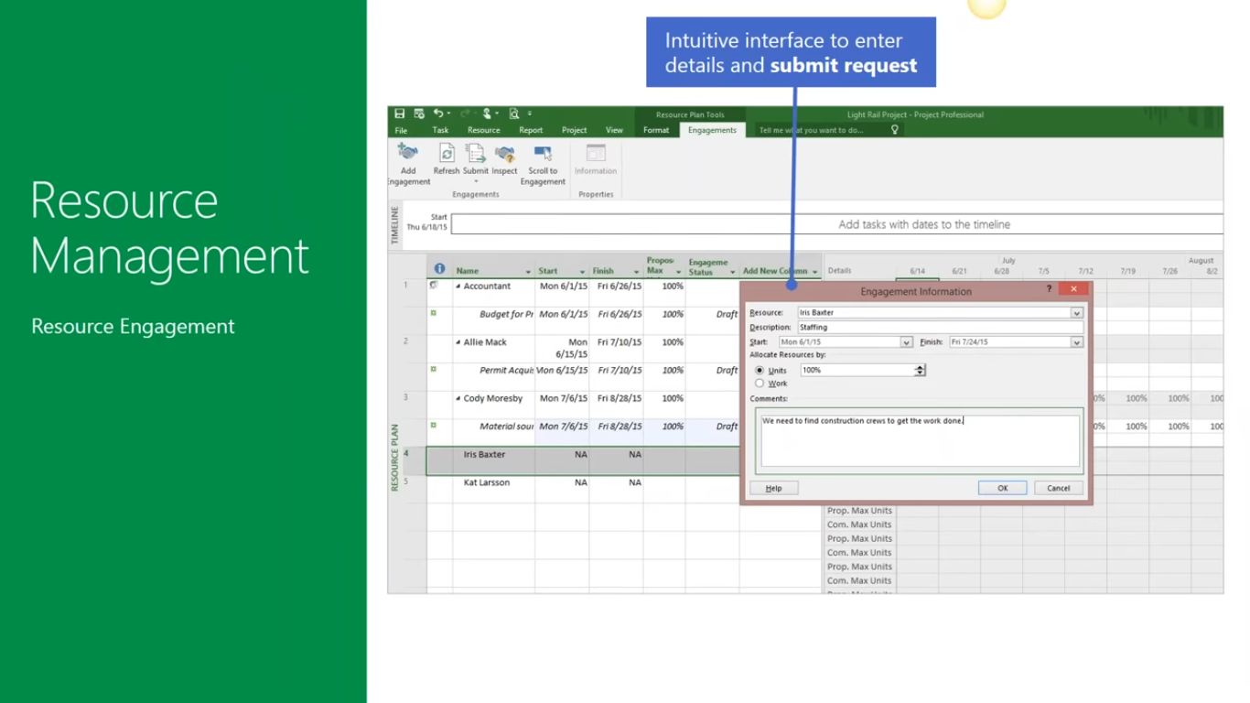

Slide 17
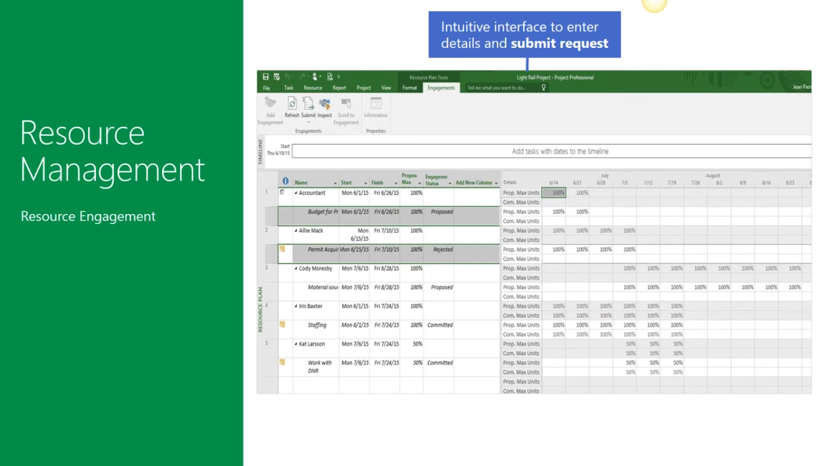

Slide 18
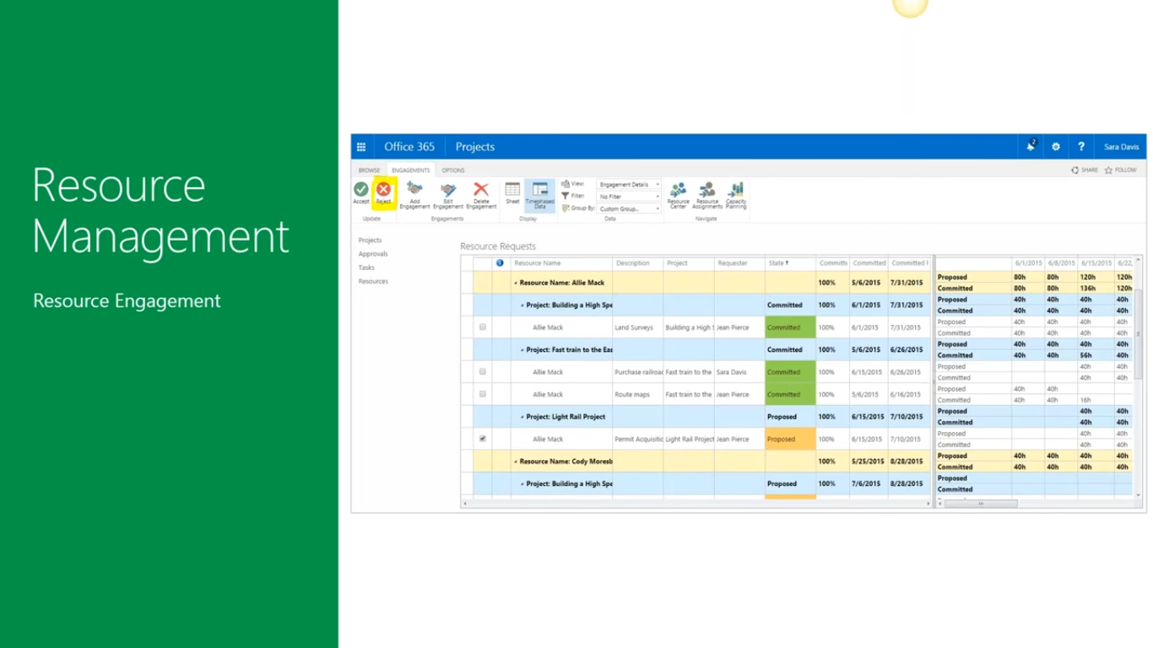

Slide 19
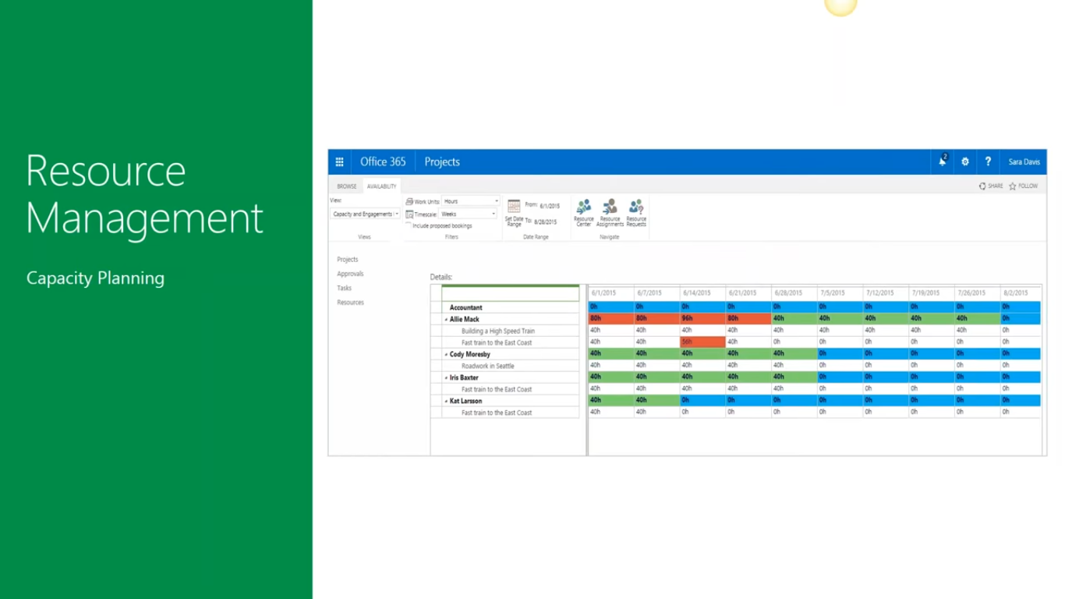

Slide 20
IT Perspective

Slide 21
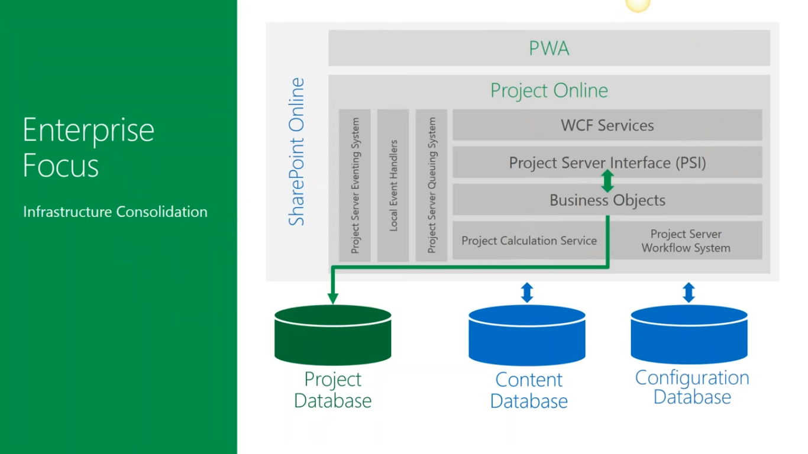

Slide 22
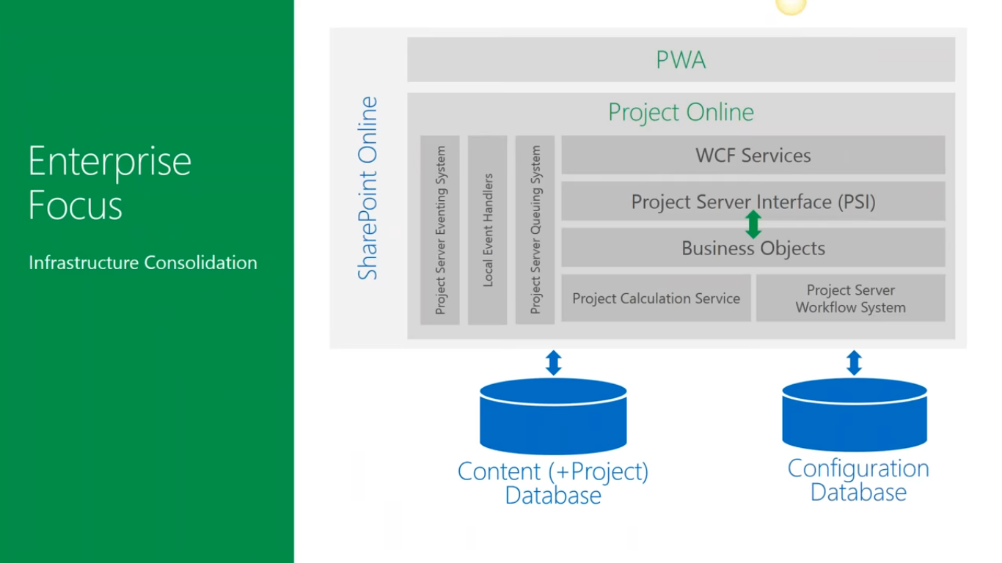

Slide 23
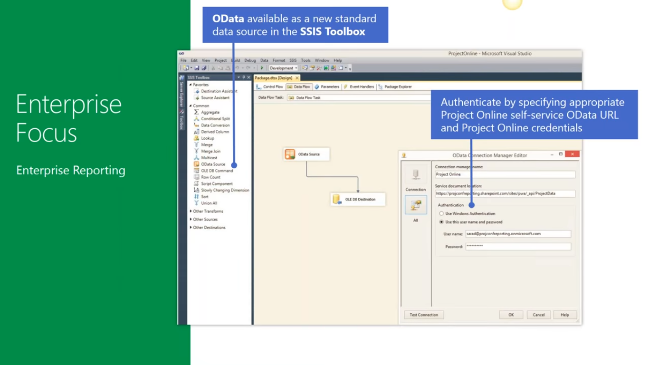
SQL Server Integration Services (a tool sits in Visual Studio). To grab the data from different databases

Slide 24
Enterprise Focus

Slide 25
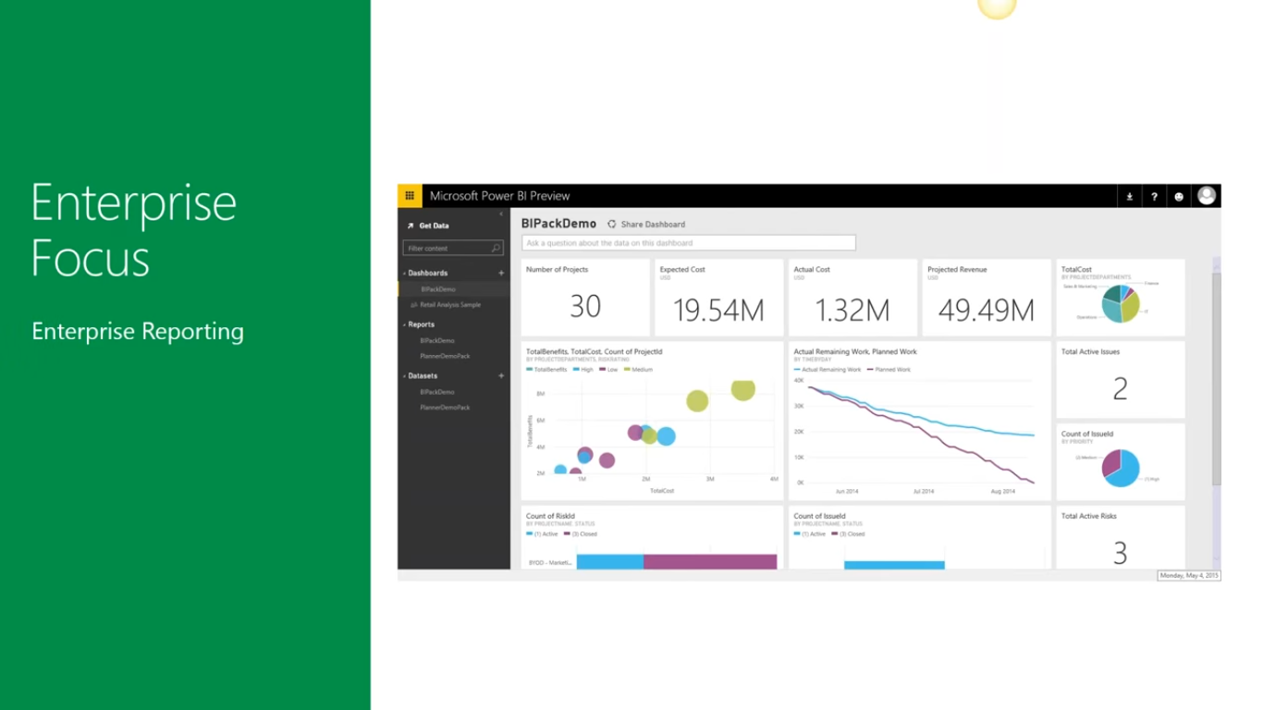

Slide 26
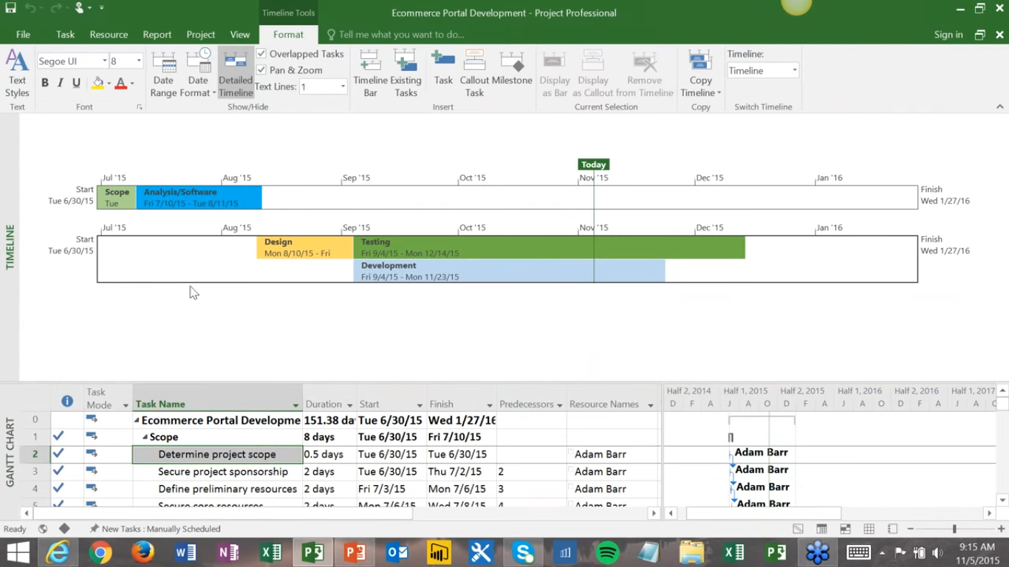

Slide 27
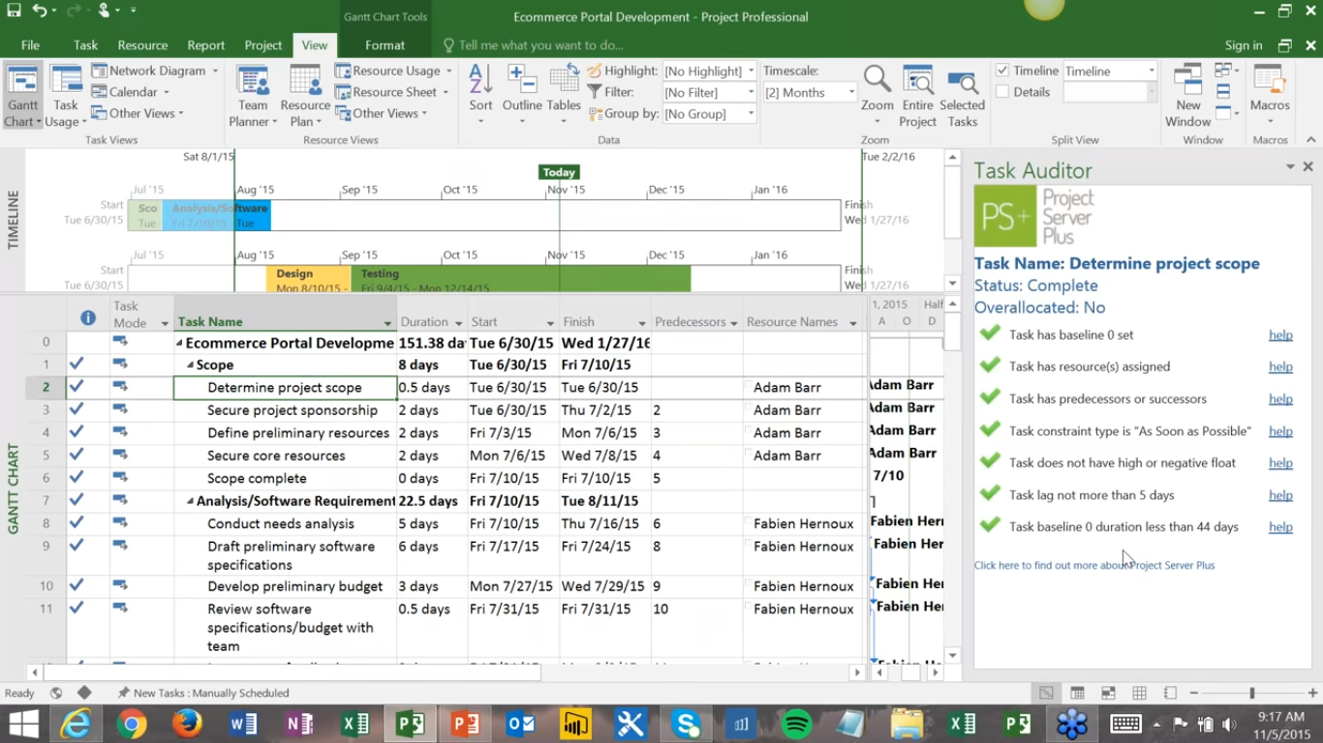
Add On Functionality. Example

Slide 28
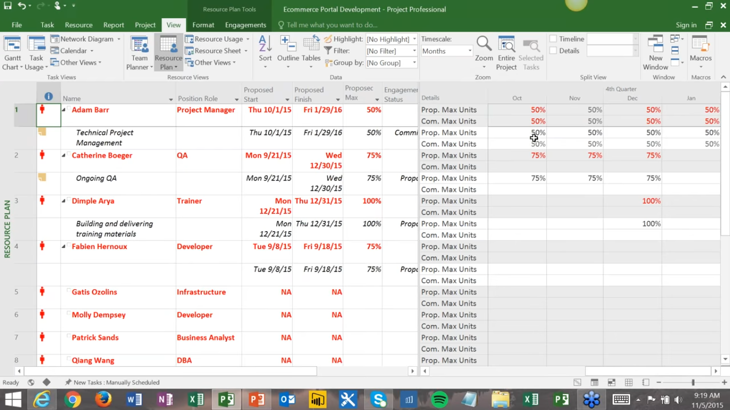

Slide 29
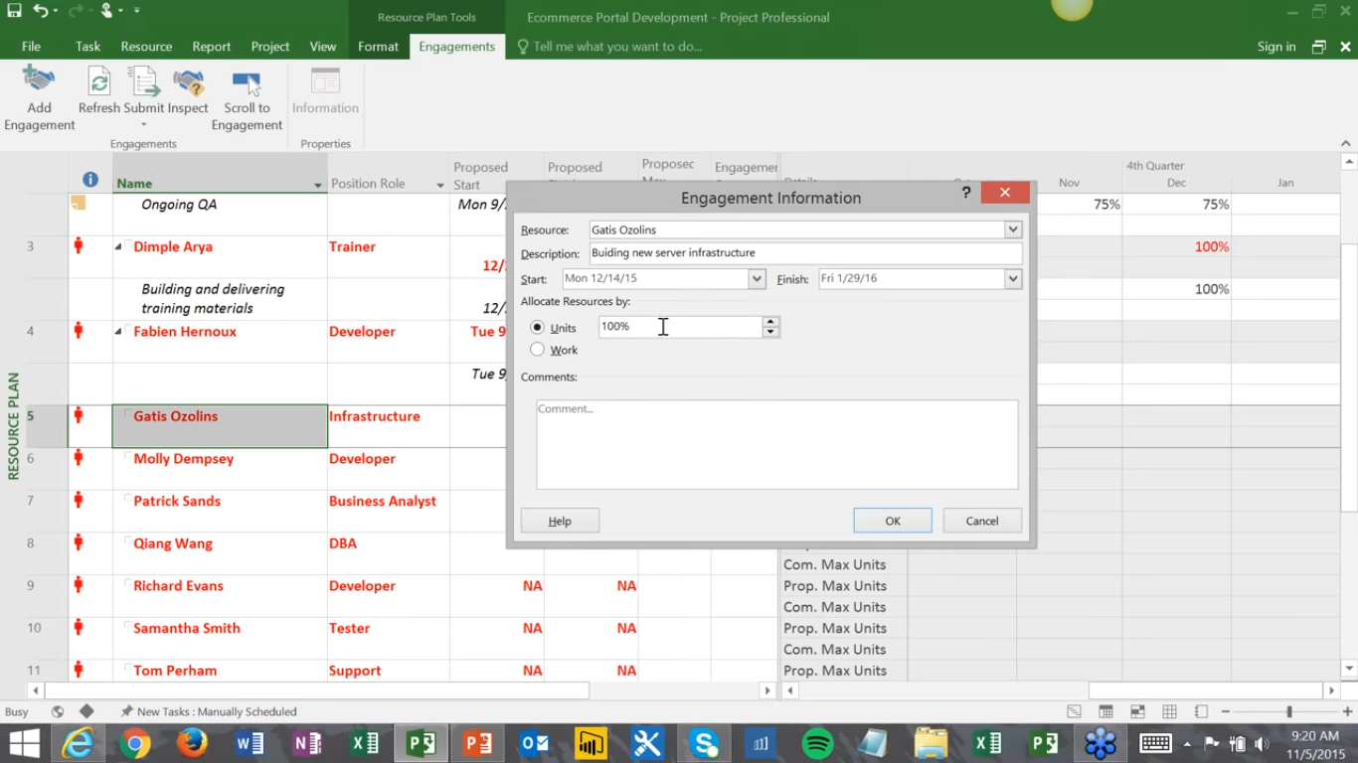

Slide 30
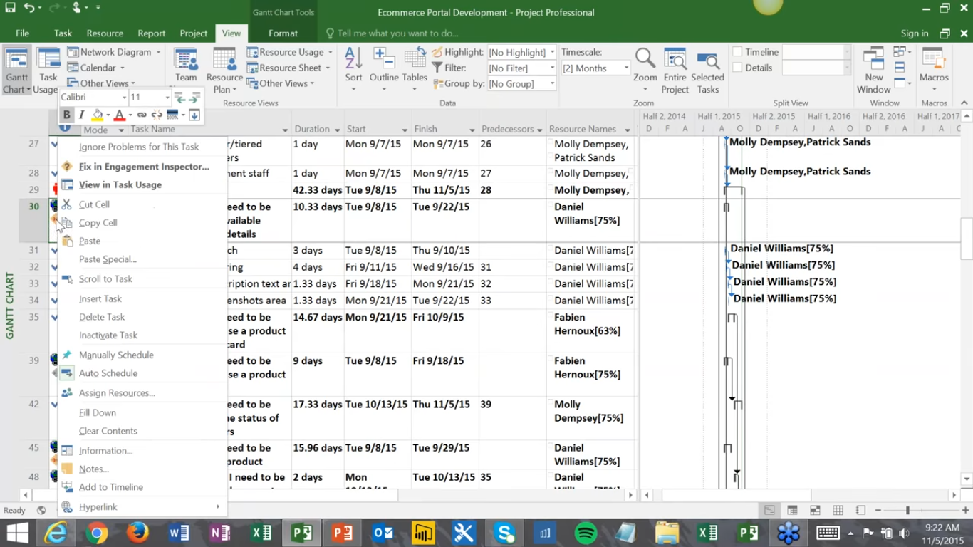
Resource is not committed to project.
So, fix this issue.

Slide 31
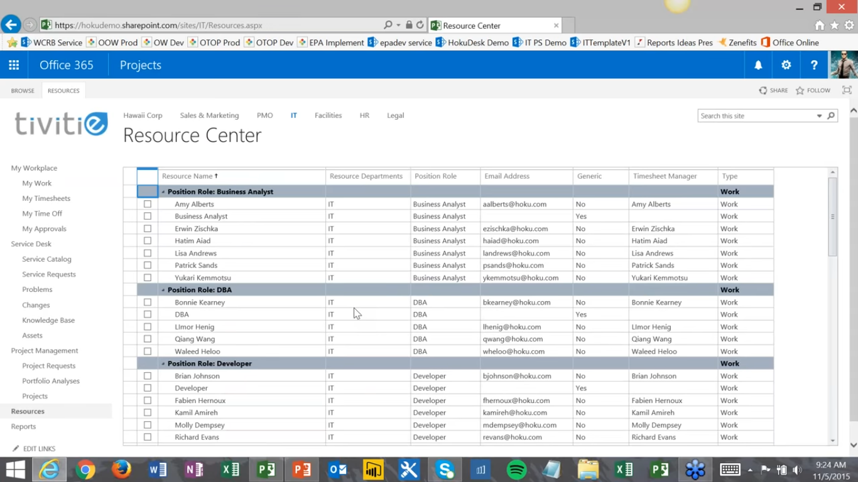

Slide 32
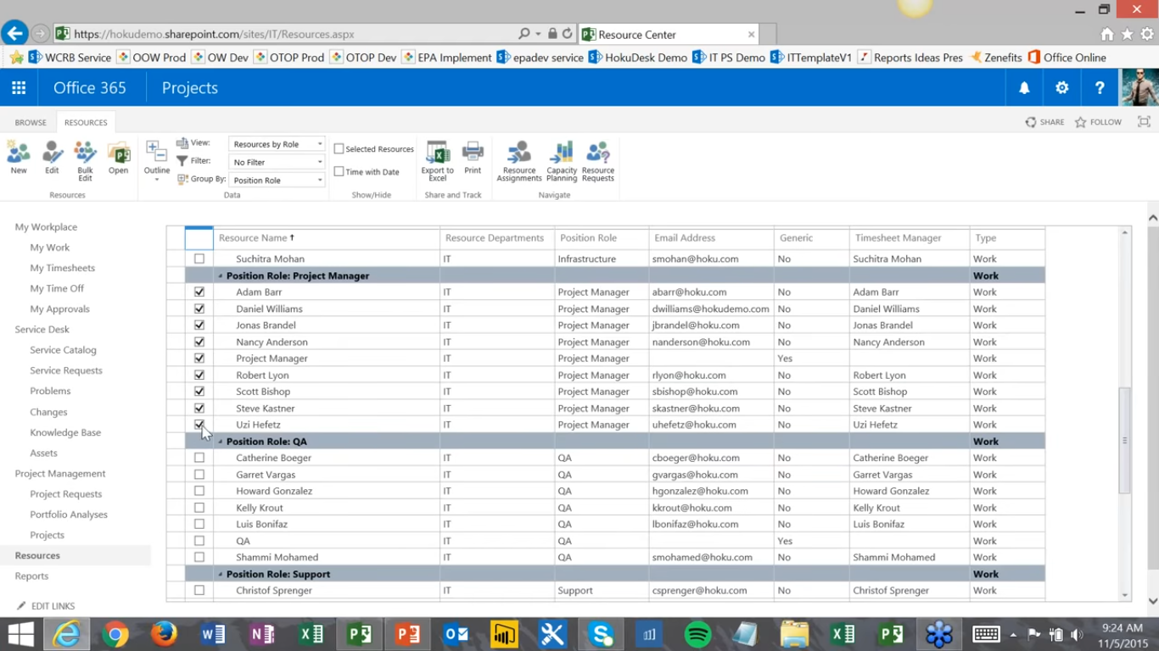
Request for resource may be Generic or Named

Slide 33
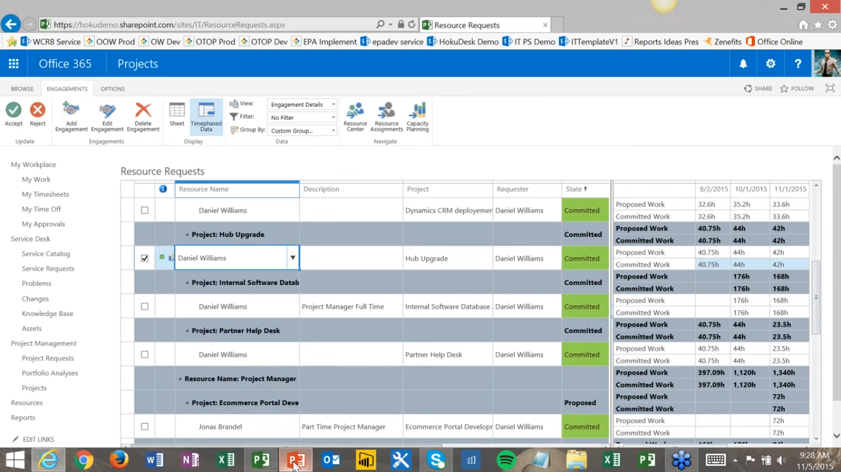

Slide 34
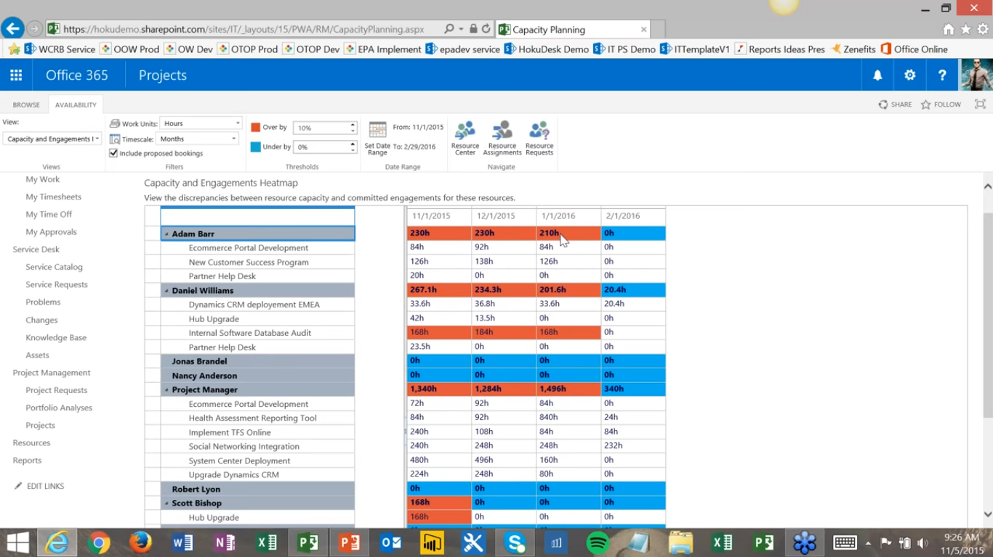

Slide 35
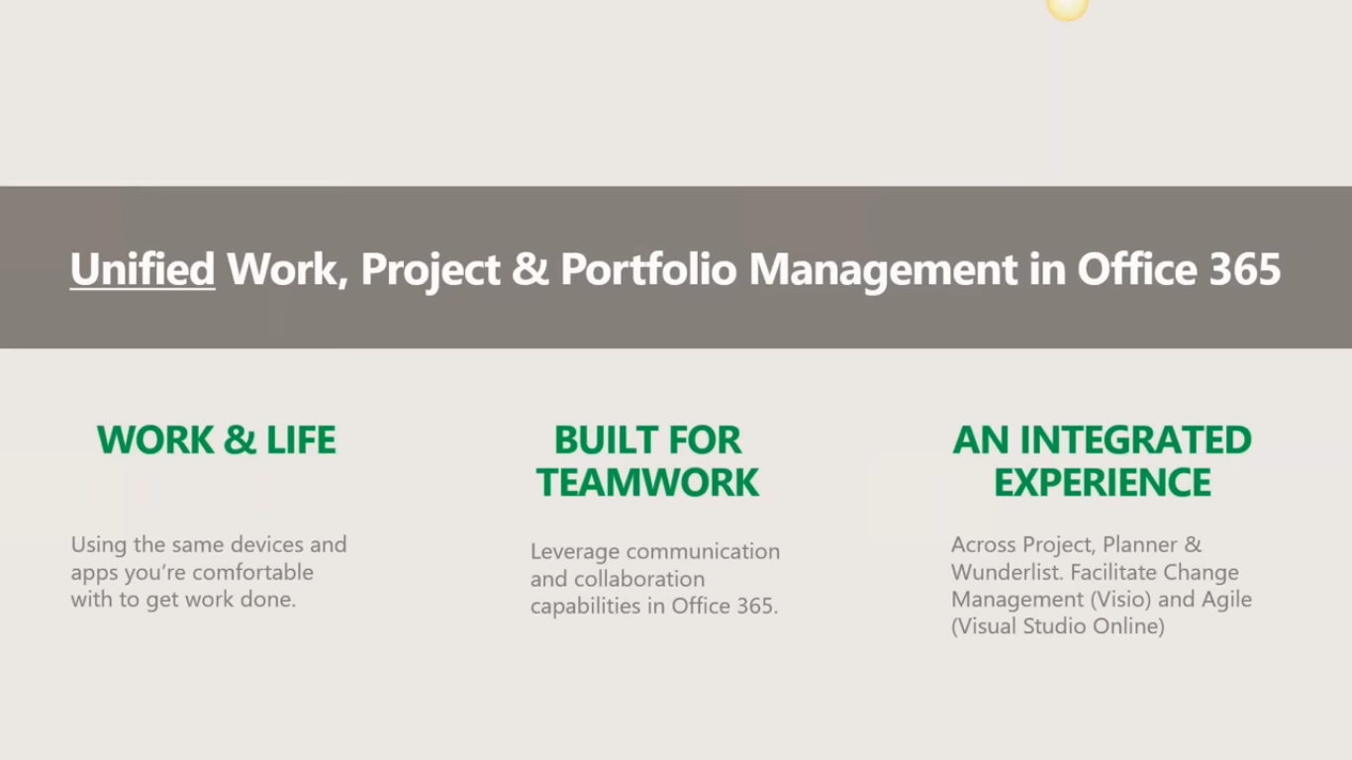

Slide 36
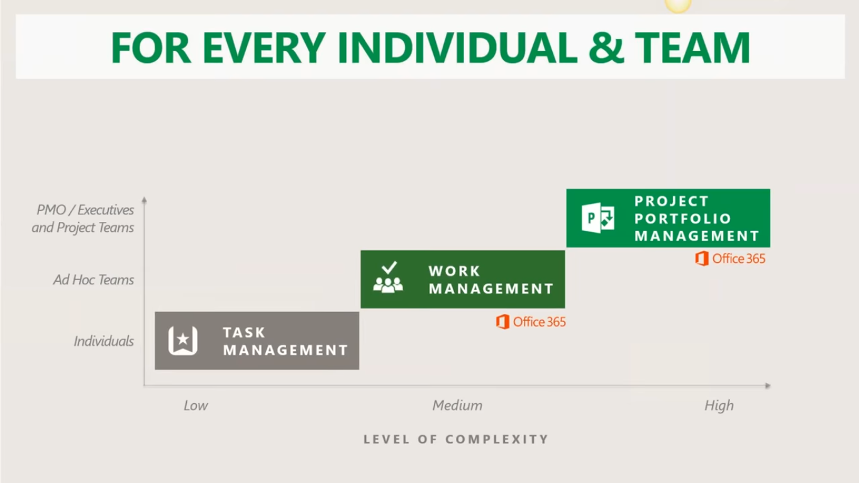

Slide 37

90% or organization using agile to manage some of their project in some agile manner

Slide 38
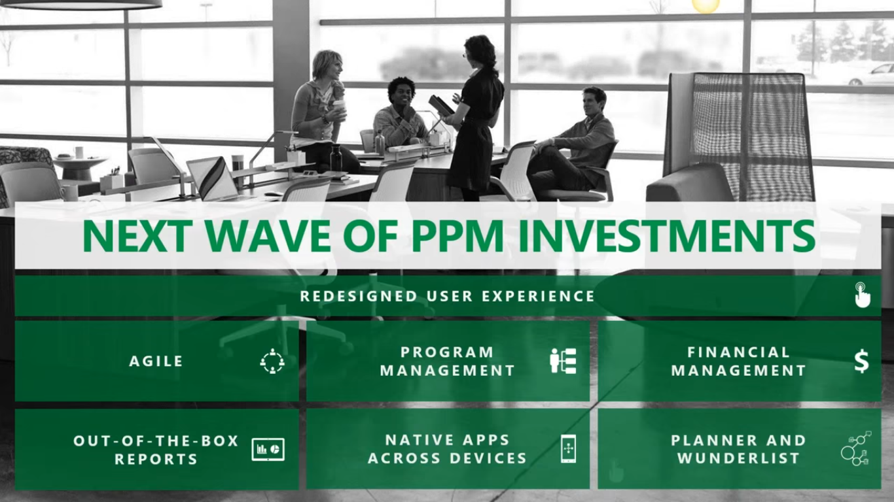
Roll up of projects to know efforts, progress etc.
Period wise break of various cost components
Various reports and dashboards on various devices/OS/Browser.
Kanban kind off.

Slide 39
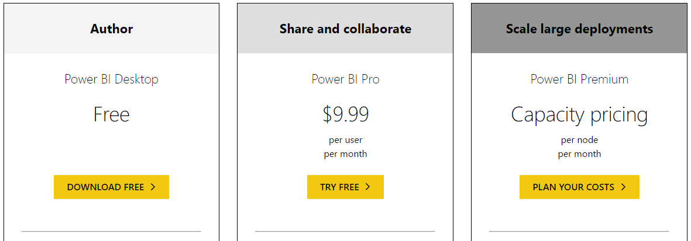
https://powerbi.microsoft.com/en-us/pricing/

Slide 40
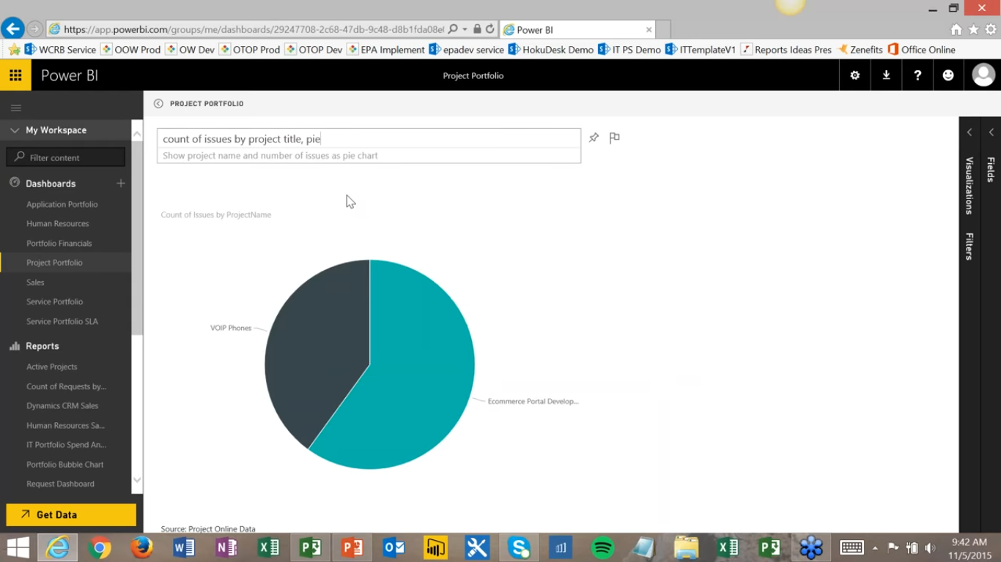

Slide 43
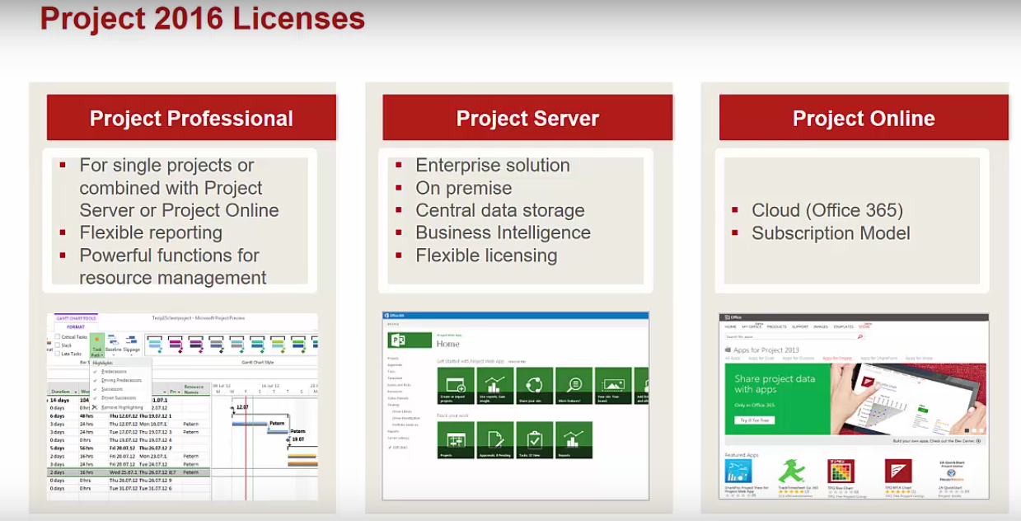
https://www.youtube.com/watch?v=dVlhStddfPk

Slide 44
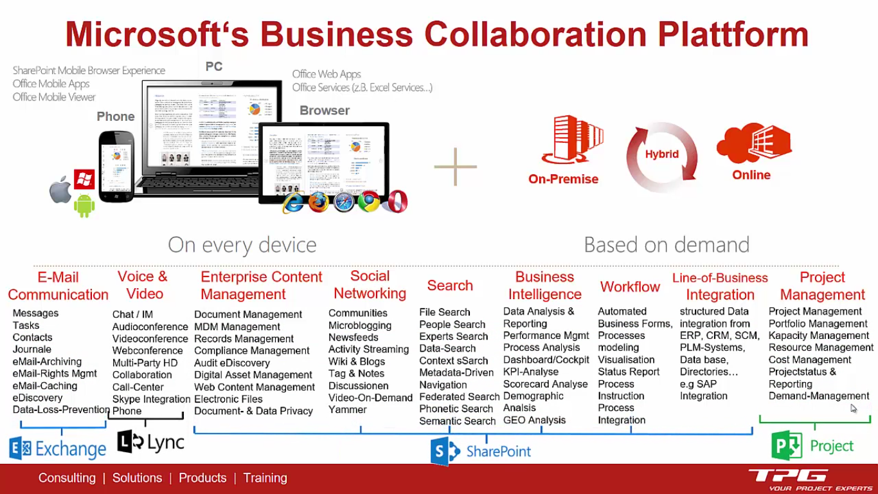

Slide 45
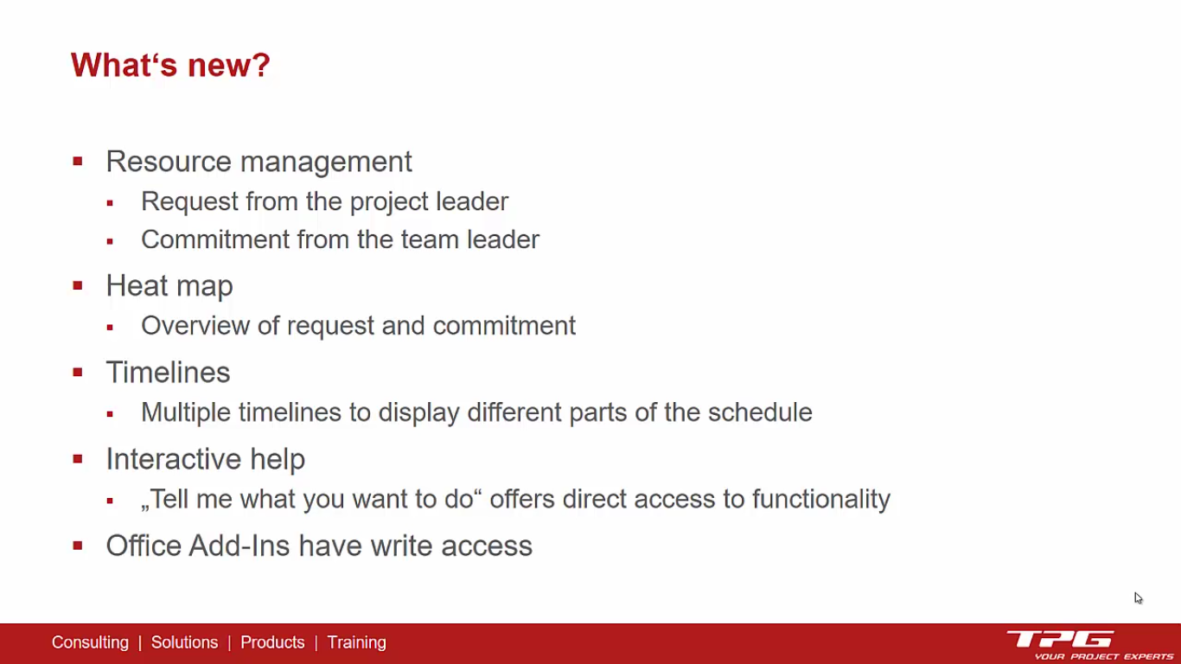

Slide 46
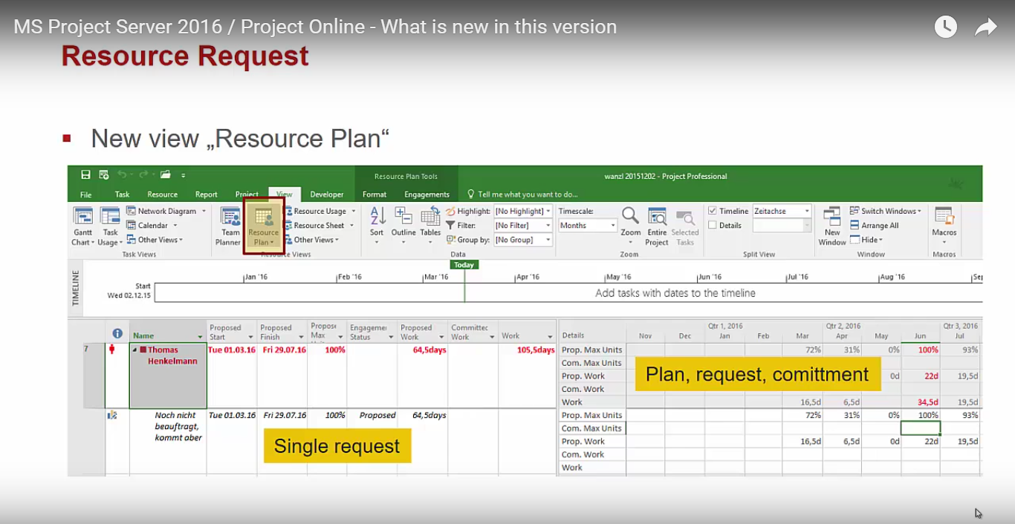

Slide 47
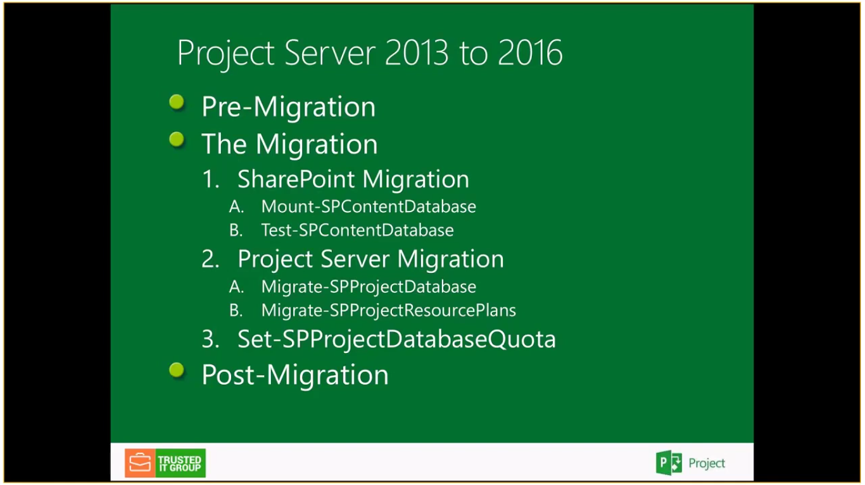

Slide 48
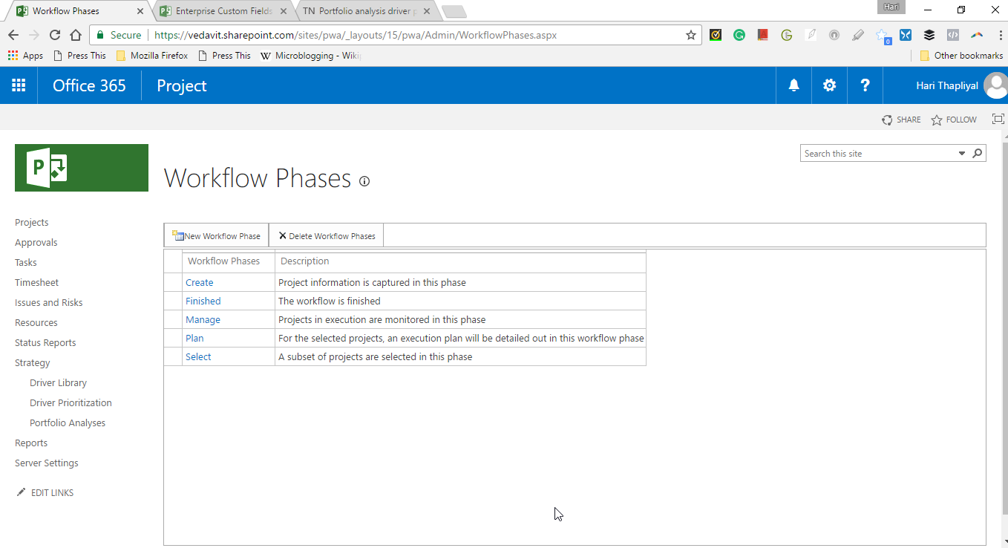
Workflow Phases

Slide 49
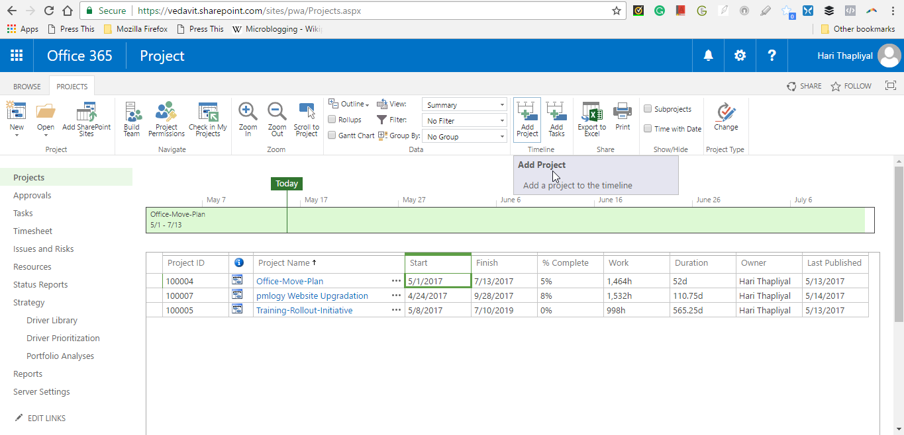
Add Project to Project Server Timeline
1
3
2

Slide 50
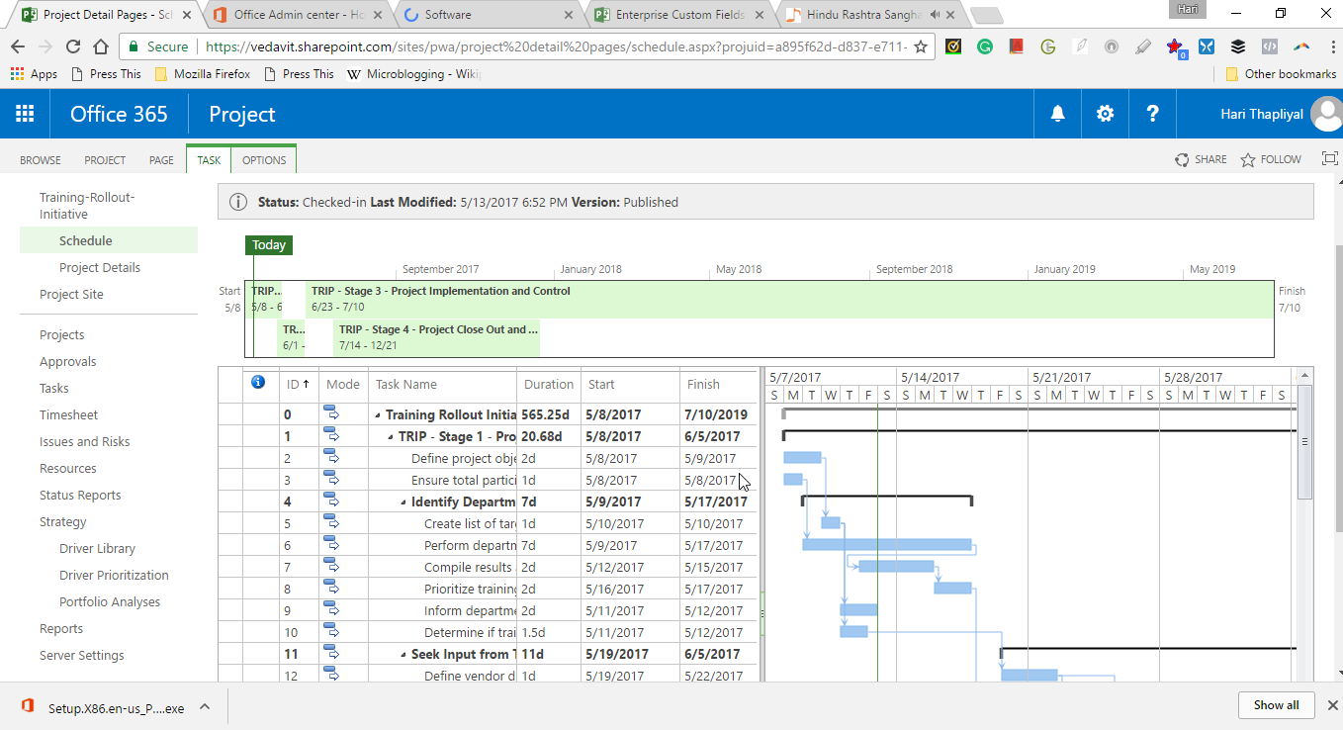
Project Detail Pages - Schedule

Slide 51
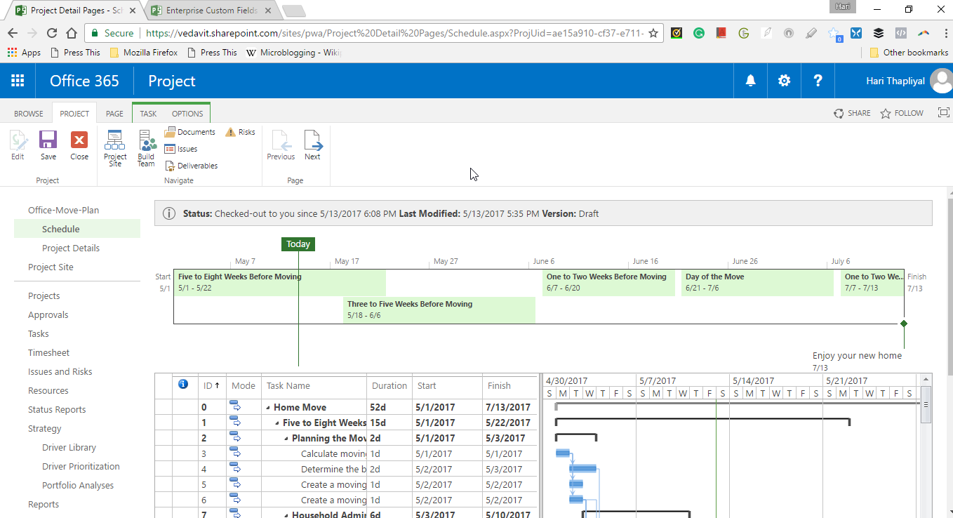
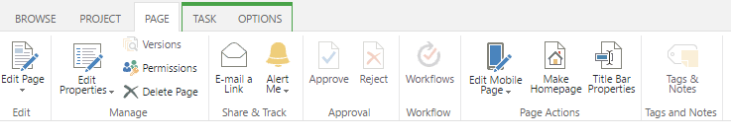
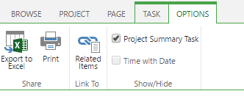
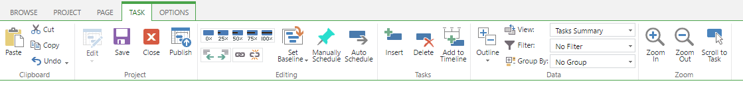
Project Detail Pages - Schedule
3
2
1
5
4

Slide 52
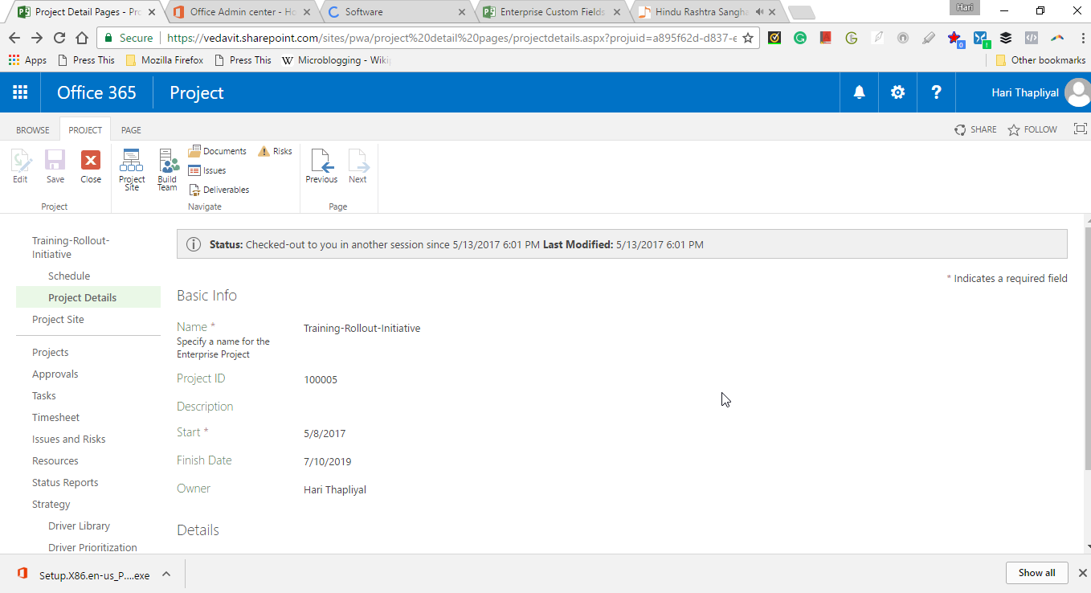
Enter Project Details via Project Detail Pages

Slide 53
Resource Management

Slide 54
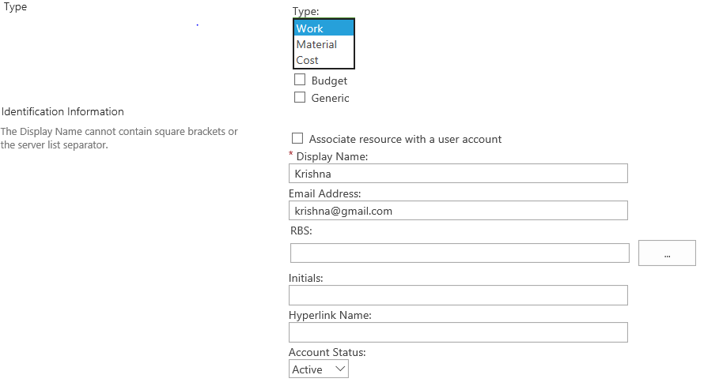

Slide 55
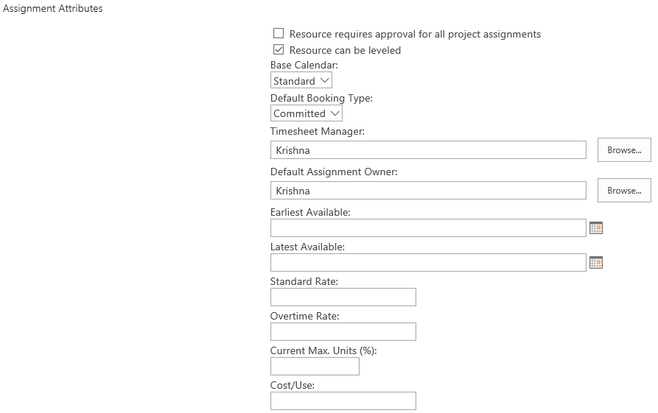

Slide 56
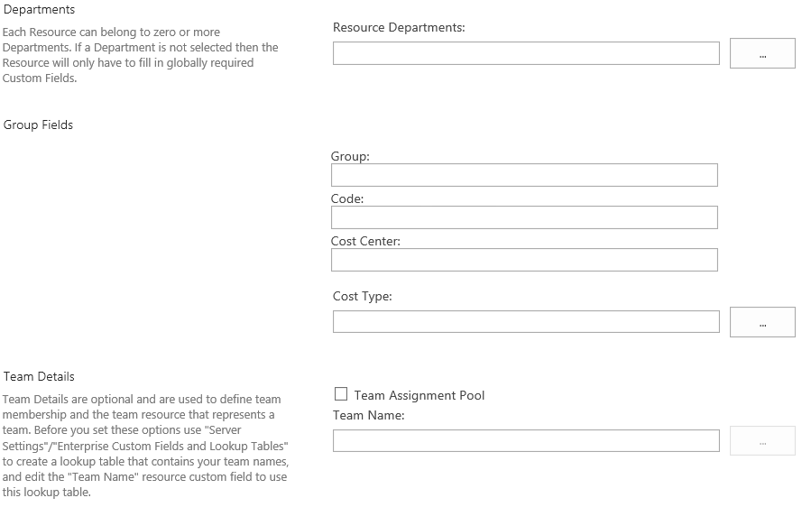

Slide 57
Types of Resources

Slide 58
Resource Assignment

Slide 59
Project Team Building

Slide 60
Resource Engagement

Slide 61
Resource Leveling

Slide 62
Task & WBS

Slide 63
Sharepoint Sites

Slide 64
Creating Project Site

Slide 65
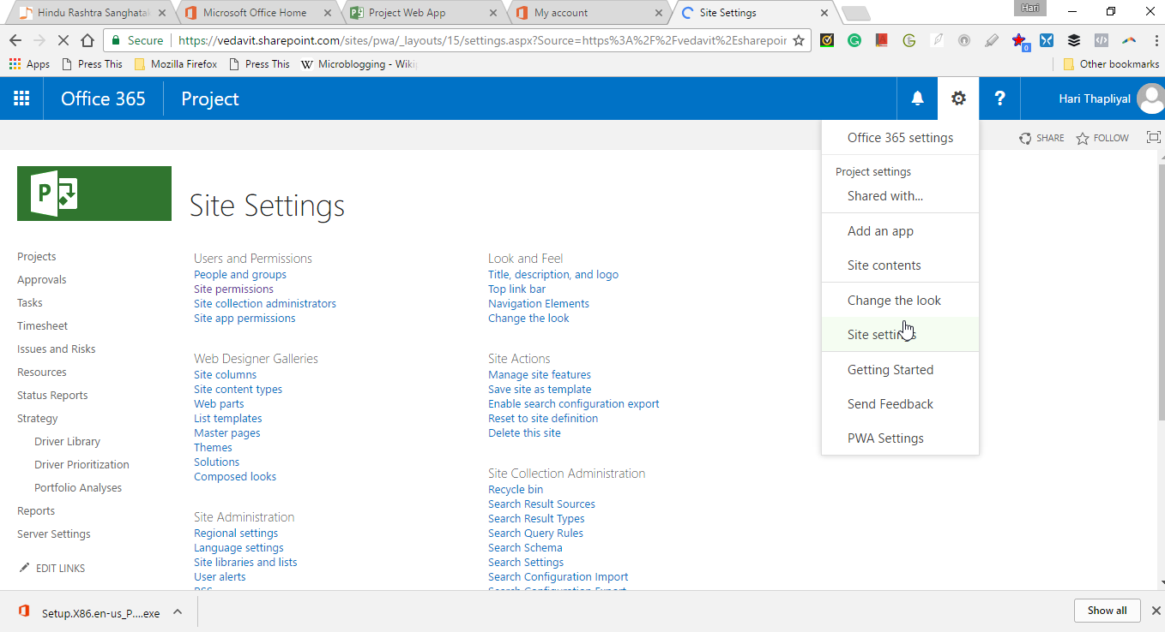
Site Settings

Slide 66
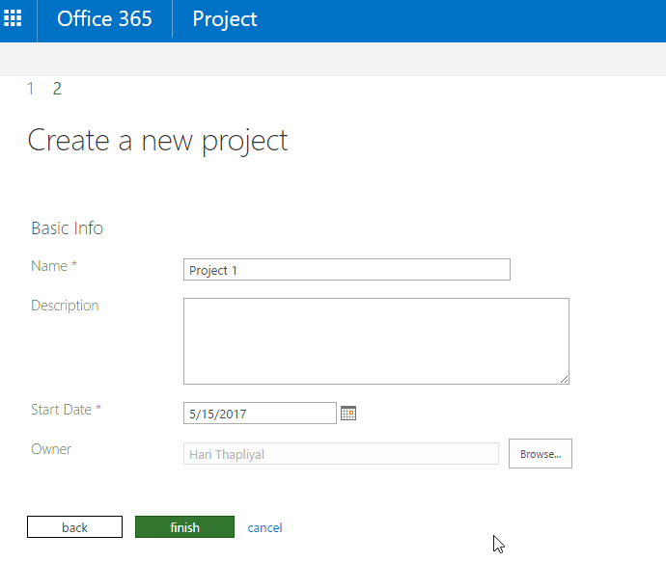
Create a new project

Slide 67
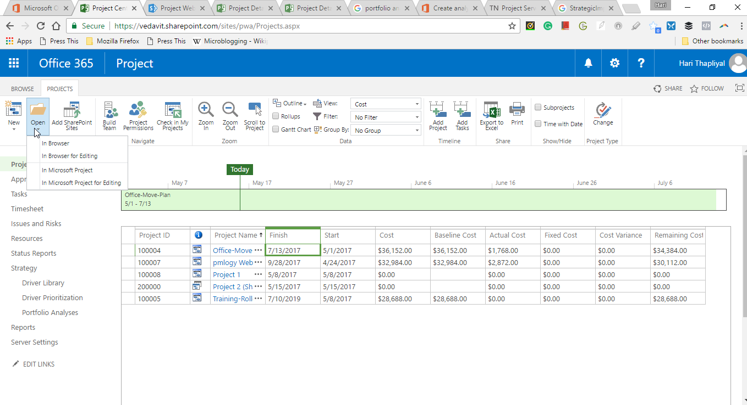
Open Existing Project

Slide 68
Create a New Project Template

Slide 69
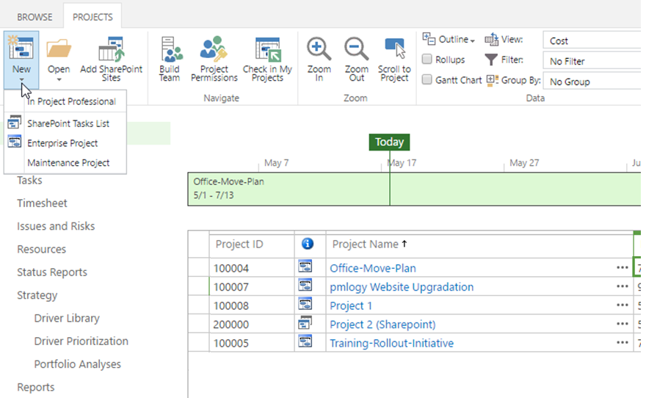
Project Center

Slide 70
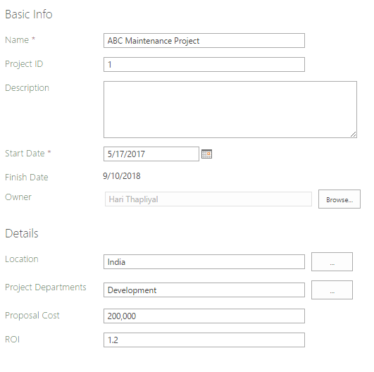

Slide 71


Slide 72


Slide 73


Slide 74

Project Detail Pages - Maintenance Project-PDP

Slide 75


Slide 76



Slide 77


Slide 78


Slide 79


Slide 80





Risk Register in SharePoint

Slide 81

Risk Register in SharePoint

Slide 82

Location: To create Deliverable

Slide 83


Deliverables List in SharePoint

Slide 84

Issue Entry in SharePoint

Slide 85

Issue Register

Slide 86



Slide 87

Force Check-in Enterprise Objects

Slide 88

Status Reports

Slide 89

How to Delete Resource

Slide 90

Resource Center

Slide 91

Modifying Multiple Resources in Project Professional

Slide 92

Project Professional - Checked-out Enterprise Resources
It is easy to modify multiple fields and multiple resources easily in Project Professional. After you modify all the records you need to save the file. Finally do not forget to publish the file, otherwise changes will not be reflected on Project Online or Project Server

